Slide 1
A Converting Casual Riders to Annual Members Case Study
Cyclistic bike-sharing company

Slide 2
0
Introduction

Slide 3
0.1 - Scenario
The director of marketing believes the company’s future success depends on maximizing the number of annual memberships.
I'm a junior data analyst, working in the marketing analytics team at Cyclistic, a fictional bike-share company in Chicago

Slide 4

0.2 - Company
Business Model
Costumer Types:
Casual Rider, that purchase single-ride or full-day passes; and
Annual Member, that purchase an annual subscription
Bicycle variety:
Classic;
Eletric; and
Docked
Stakeholders
Cyclistic marketing analytics team, responsible for collecting, analyzing, and reporting data that helps guide Cyclistic marketing strategy;
Lily Moreno, the Director of marketing, is responsible for the development of campaigns and initiatives to promote the bike-share program; and
Cyclistic executive team, the notoriously detail-oriented executive team will decide whether to approve the recommended marketing program
Facts and Numbers
5,824 bikes;
692 docking stations;
More than 50% of riders select traditional bikes;
8% of riders opt for the assistive bike options;
30% of users bike to commute to work each day;
Users are more likely to ride for leisure; and
Casual riders have chosen Cyclistic for their mobility need

Slide 5
0.3 - Problem
How casual riders and annual members use Cyclistic bikes differently?
Which marketing strategy would be most effective in converting casual users into members?

Slide 6

The six steps of data analysis (Google method)
1 - Ask
2 - Prepare
3 - Process
4 - Analyze
5 - Share
6 - Act
0.4 - Scope of Work
A clear statement of the business task
A description of all data sources used
Documentation of any cleaning or manipulation of data
A summary of your analysis
Supporting visualizations and key findings
Top three recommendations based on the analysis

Slide 7
1
Ask

Slide 8
1 - Ask
A clear statement of the business task
How casual riders and annual members use Cyclistic bikes differently?
Design a new marketing strategy to convert casual riders into annual members
To solve these problems, me and the marketing analyst team needs to answer:
how annual members and casual riders differ?
why casual riders would buy a membership?
how digital media could affect their marketing tactics?

Slide 9
2
Prepare

Slide 10
2 - Prepare
A description of all data sources used
The data are stored at this link and organized by month. Since there is no filter, or previous calculating in the raw data and all the consumer are included, we concluded that there is no issues with bias or credibility in the data. To ensure that, we used the ROCCC system:
R – Reliability
Completeness, missing values represents 3.58% from the total and it’s smaller than 10% of statistical significance. So, it’s ok.
Consistency, 0,03% from the total of registries that haves datetimes starting before start datetimes. In this specific cases we can’t fix it, the percentile is to small so the data will be disregarded and will be ok
Primary-key, There is to much primary keys and with this problem will be more difficult to clean and work with the data, so we can solve it just by filtering variables according to the actual step
O – Originality
The data is original, just with a different name because Cyclistic is a fictional company
C – Comprehensiveness
This database is comprehensive enough
C – Current
The database are up to date and updated monthly
C – Cited
The data is sourced by a first-party group (Motivate International Inc.), under this license.

Slide 11
3
Process

Slide 12
3 - Process
Tool
No filter
Check it out
Documentation of any cleaning or manipulation of data
All this step was completed in RStudio
To maintain the data integrity all the data will be merged and loaded
To access the full report and the documentation, please, visit the link. This step starts at row 136 to row 329.
* after merged the data contains
5,378,834 rows
*Obs.: This step don’t have the details, the main objective of this presentation are the visuals.

Slide 13
4
Analyze

Slide 14
4 - Analyze
Tool
Studies
01
03
Tecnique
Check it out
02
04
A summary of your analysis
All this step was completed in RStudio too
Count: the frequency of records
Length: The ride length in minutes
This step will be splitted into two studies: Count and Length
To access the full report and the summary, please, visit the link. This step starts at row 332 to row 491.
*Obs.: This step don’t have the details, the main objective of this presentation are the visuals.

Slide 15
5
Share

Slide 16
5 - Share
5.1 - Count Study
5.2 - Length Study
5.3 - Map Study
Supporting visualizations and key findings
Unlike the previous step, this study will be divided into three parts:
Tables and Plots by RStudio
Tables and Plots by RStudio
Tables and Plots by Power BI and Tableau

Slide 17
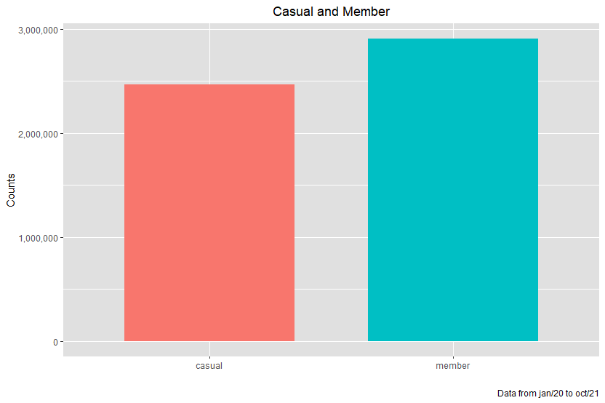
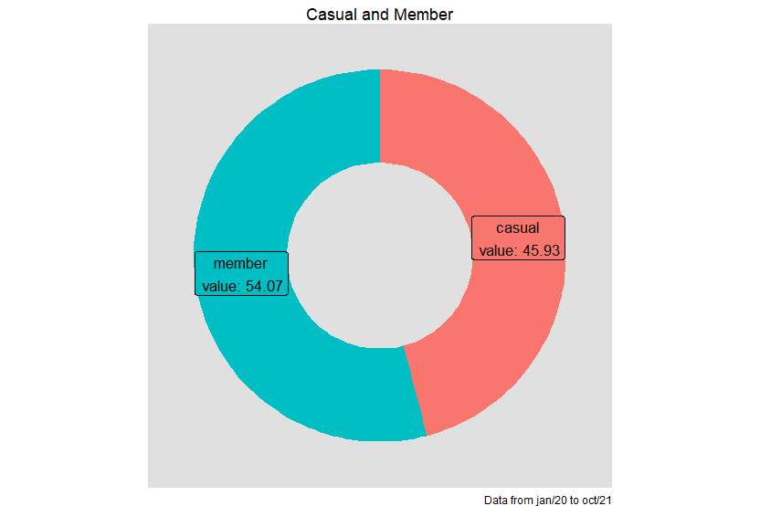
5.1 – Count Study
5.1.1 – Casual and Member Overview
As we can see, most of the rides data are from annual members, but it's not so different

Slide 18
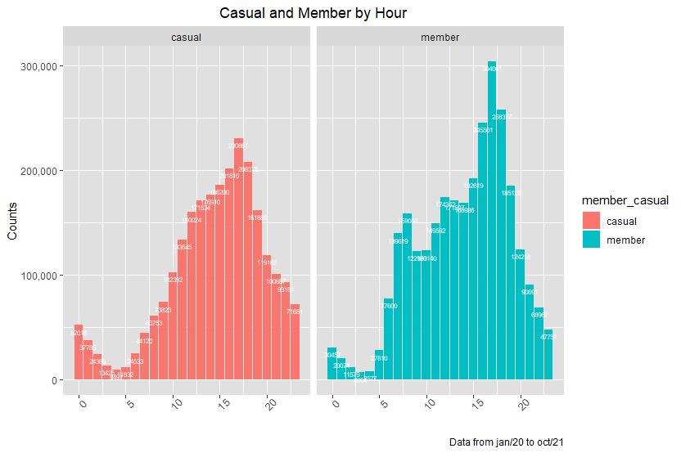
5.1 – Count Study
5.1.2 – Casual and Member by Hour
Members and Casuals are different when the variable is the hour to ride. While Members ride mostly at 7am to 7pm, a few Casuals ride at the morning. At night there is more Casuals than Member riding (as we see before, there is more Annual Members than Casuals Riders).

Slide 19
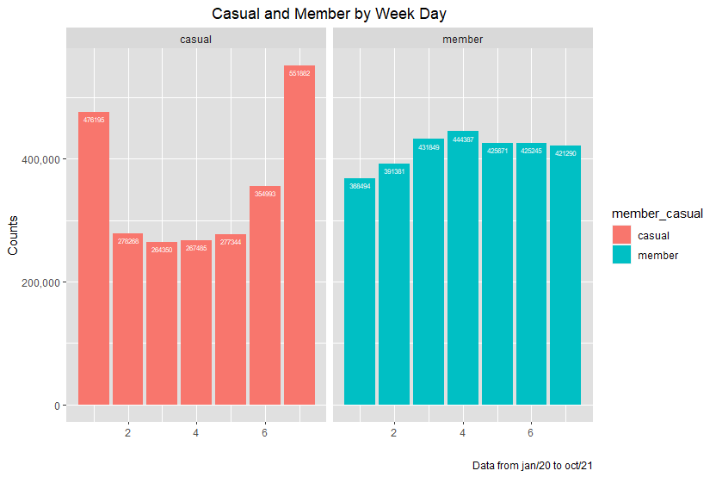
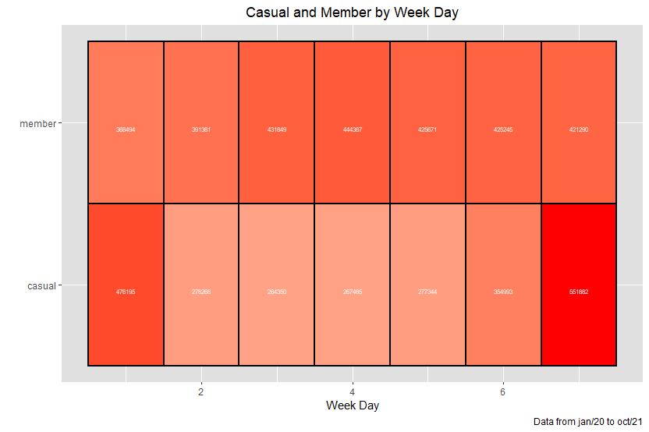
5.1 – Count Study
5.1.3 – Casual and Member by Week Day
Here is a big difference: Casuals ride much more on Sundays (the first bar) and Saturdays (the last bar), while Members ride constantly in week days.

Slide 20
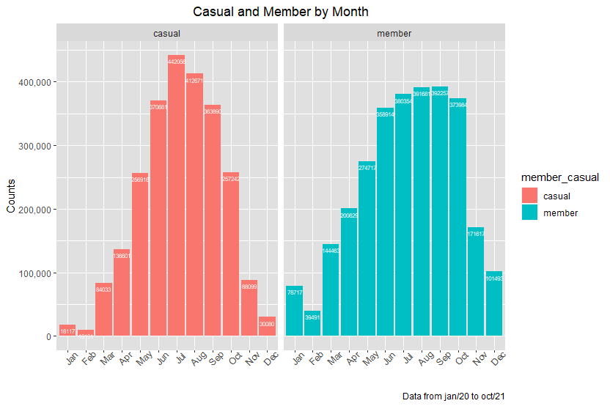
5.1 – Count Study
5.1.4 – Casual and Member by Month
Both ride more at the summer and less at the winter.

Slide 21
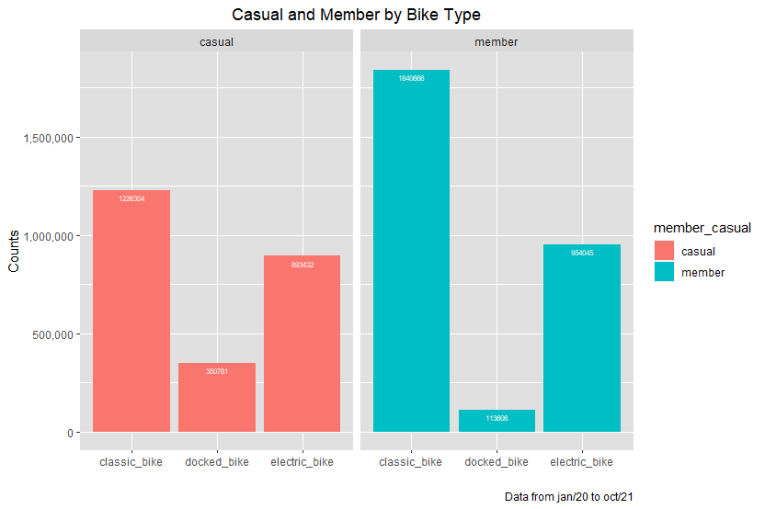
5.1 – Count Study
5.1.5 – Casual and Member by Rideable Type
Members use much more the classic bike than the docked bike if we compare with Casuals

Slide 22
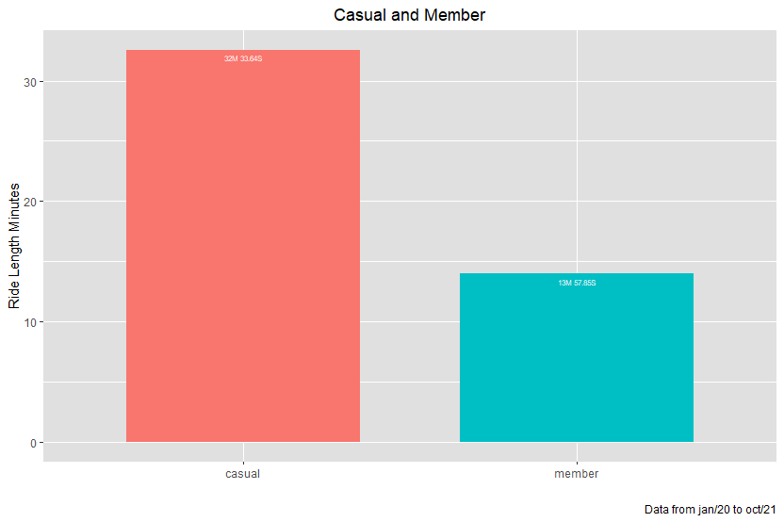
5.2 – Length Study
5.2.1 – Casual and Member Overview
Casuals users spend twice time more than Members pedaling

Slide 23
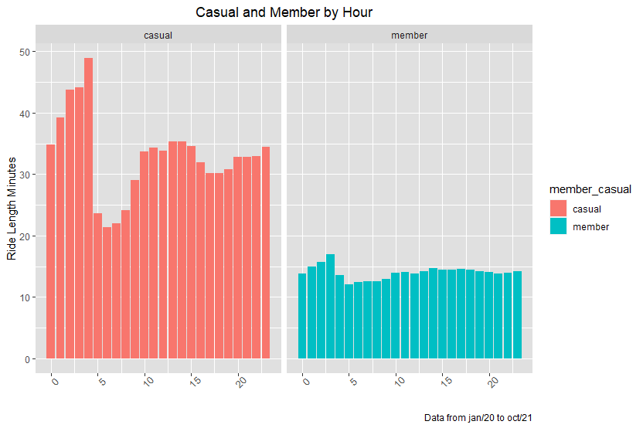
5.2 – Length Study
5.2.2 – Casual and Member by Hour
The length of the rides of members are smaller and more constantly than casuals.

Slide 24
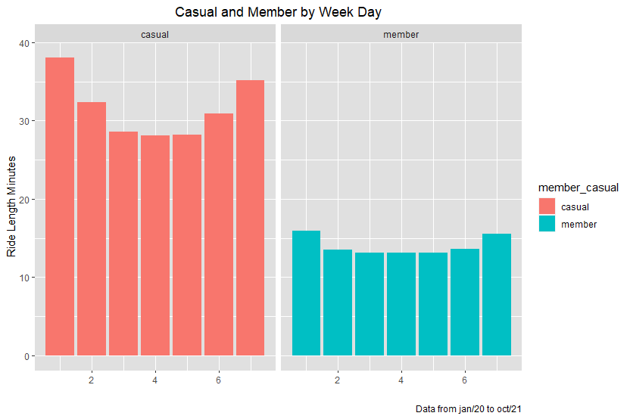
5.2 – Length Study
5.2.3 – Casual and Member by Week Day
At Sundays and Saturdays Casuals spend more time riding

Slide 25
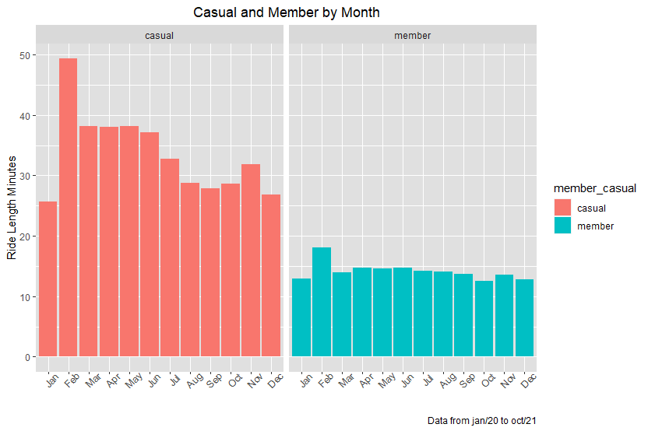
5.2 – Length Study
5.2.4 – Casual and Member by Month
Independent of the month, Member's ride length are similar

Slide 26
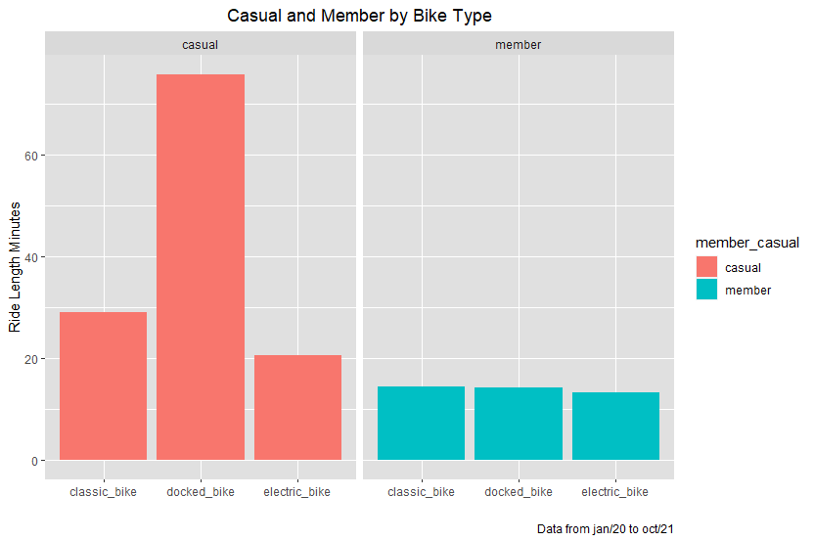
5.2 – Length Study
5.2.5 – Casual and Member by Rideable Type
Casuals spends more time for the docked bike type

Slide 27
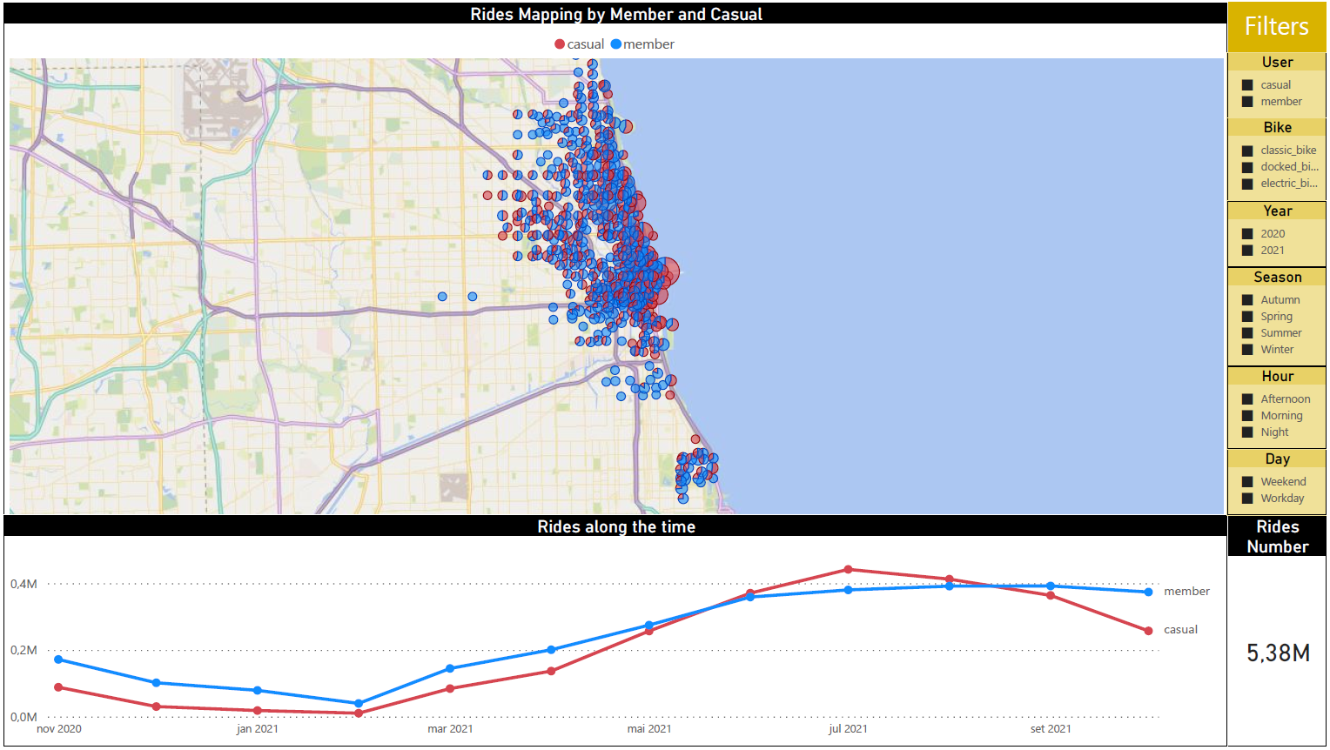
5.3 – Map Study
5.3.1 – Stations where Members and Casuals most unlock bikes
Casuals depart manly from the waterfront stations, while Members depart from the city center.

Slide 28
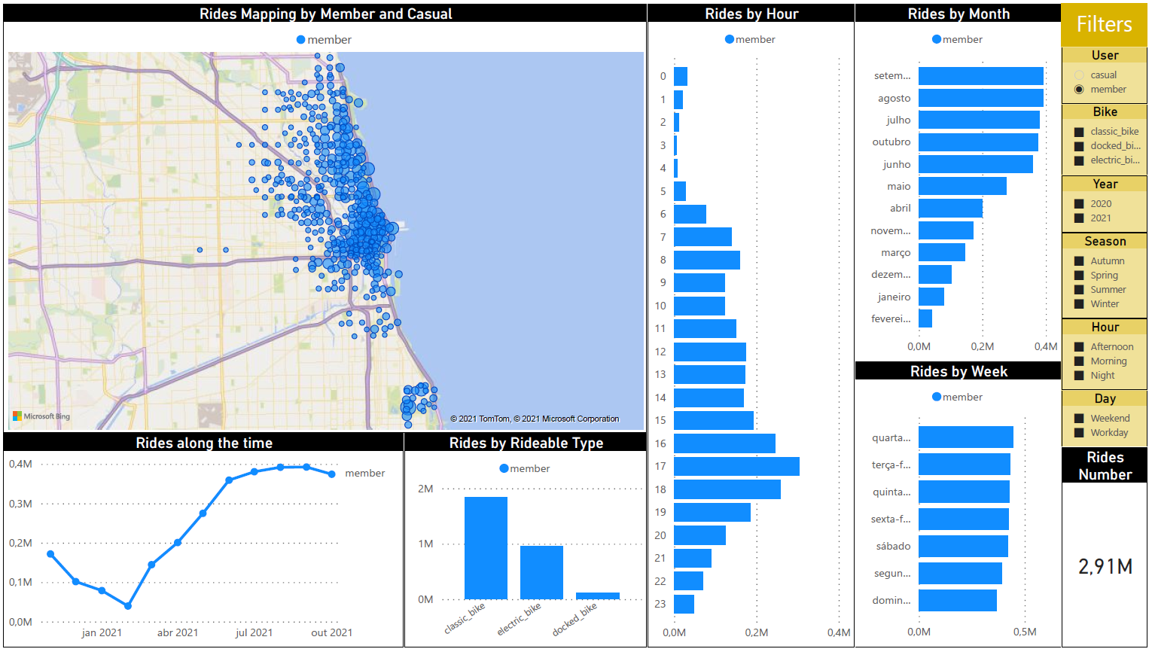
5.3 – Map Study
5.3.2 – Member overview

Slide 29
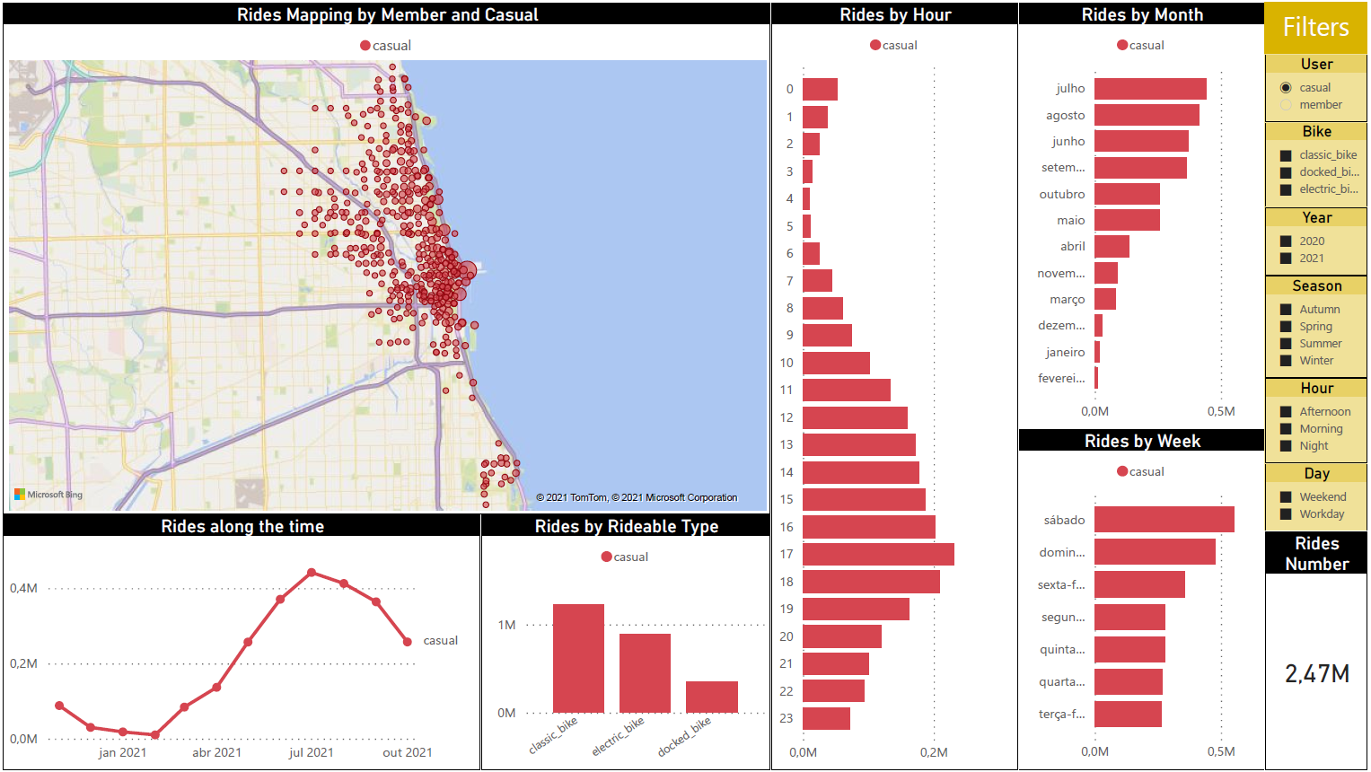
5.3 – Map Study
5.3.3 – Casual overview

Slide 30

5.3 – Map Study
Additional dynamic visualization (Tableau Public)
As it is not possible to publish through Power BI without a subscription, I created a dashboard through Tableau. With that it will be possible to filter the data and specific insights. To access, please, click on the following link

Slide 31
5.4 - Key Findings
5.4.1 – Differences and Similarities
Members
Most ride at work time, at 7am to 7pm
They use constantly on weekdays
Use much more the classic bike (16x) than the docked bike when compared with Casuals (3.5x)
Rides depart mostly in the city center
Casuals
Just few Casuals ride at morning
Although Members majority, at night Casuals are majority
Ride much more on Sundays and Saturdays
Independent of the day of week, time, month or bike type, Casuals spend twice time riding if compared with Members
Rides depart mostly on the waterfront
Both
Ride more at the summer and less at the winter

Slide 32
5.4 - Key Findings
5.4.2 – Speculations
Based on previous information, with just one relevant finding to both and many differences to each one, we presume that, they intent to use is for distinct reasons. And these reasons we make the following assumptions:
Casuals primarily use Cyclistic bikes for leisure; and
Members primarily use Cyclistic bikes for commuting to work or another routines

Slide 33
6
Act

Slide 34
6.1 - Recommendation I - Convert Casuals to Member assertively
Design an annual plan for weekend users
Be assertive in the marketing strategy
Hit the target
It's not possible to design a new marketing strategy that converts all the Casuals to Members and get satisfactory results, because as we saw before, they have different reasons to ride.
So, the solution is to create a plan to these specific riders. According to the records of the database, they represent almost 20% from the total
How can we convert Casuals to Member if they apparently don't want this commitment? Highlighting:
the mental health benefits of having leisure time, at least weekly;
the health benefits of keep moving, riding constantly; and
the real discounts, in a transparent and easy to understand way
In few words, the campaign theme can be: more leisure, more healthier and more savings for Casuals riders
Just a good strategy is not enough, you have to hit the target. These kind of marketing action may work:
Traditional Publicity
Outdoors and Displays along the Chicago waterfront;
Distribution of leaflets on weekends near Chicago bike stations;
Create partnerships with food and beverage commerce along the maritime coast, like earn discount by being a Member at these stores; and
Install campaign display on bicycles
Digital Publicity
With an mobile app (suggested later, at the Recommendation III), notify Casuals about the campaign; and
Posts on social medias like (Instagram and Twitter), filtering by Chicago, at Weekends, through Digital Influencers focused in healthy habits and sports.
Establish a good trade between cost and benefit
But, this have to be not just more economic than the other annual plan, but a win-win relationship client and must be clear to the client's understanding
Keep up a great job of bicycle logistics
After implanted this plan, maybe some dock station will be busier and another less busy. It's important to track closely, in order to avoid bicycle leftovers and shortages.

Slide 35

6.2 - Recommendation II – Create data-driven decision making culture
Know more to be more engaged and with a better reputation
Make the relationship stronger and closer through the app
If the company wants more loyalty from the clients, more data about they will be necessary.
Knowing consumer's age, genre, where they lives and the main reasons to ride enables the company to create marketing actions more accurate and create products more adapted to customers needs.
And, consequently more connection, more empathy and a longer relationship
A good and practice way to get consumer data is through the company's app. Create incentives to keep them moving, such as a monthly goal would be an excellent strategy for them to constantly use the app

Slide 36

6.3 - Recommendation III - Increase Consumer Loyalty
Create a loyalty plan for Members
Create a discount system for annual plan renewal
In addition to making even more loyal those who are already a Member, this examples will encourage Casuals to be a Member:
Discipline points
At 3 months using every week, earns 20 Ciclystic Points;
At 6 months using every week, earns 40 Ciclystic Points;
Distance covered points
At 500 covered miles, earns 40 Ciclystic Points;
At 1000 covered miles, earns 80 Ciclystic Points;
Friends indication points
At the third indication for any annual plan, earns 160 Ciclystic Points (after payment confirmation);
At the sixth indication for any annual plan, earns 200 Ciclystic Points (after payment confirmation);
Awards personalized by Ciclystic:
A Towel for 20 Ciclystic Points;
A T shirt for 40 Ciclystic Points;
A Cap for 80 Ciclystic Points;
A Thermos bottle for 150 Ciclystic Points; and
A Bicycle helmet for 200 Ciclystic Points.
For those who are already a member and wants to renewal the annual plan, regardless if the plan is to every day or just on weekends, concede (just for an example) 5% off.

Slide 37



Thanks!
Do you have any questions?
Thiago Pierre Pasolini
+55 49 98826 1933
thiagopierrepasolini@gmail.com
Credits: This presentation template was made by Slidego and icons by Flaticon

